Slide 1


Economy: 6 pillars + theory + current + BES17 (pre cum Mains)
1.Banking, Fin, Insur.
6.HRD
2.Budget
3.BoP
4.Sectors
5.Infra
V1:c3,4
V1:c2,3, 6,9,11(GST),13
V1c:5
V1c:7,11(Agri)
V1c:10
v1c:12, 14; Budget^Rail
Banking, Finance, Insurance, Fin. Inclusion

Slide 2
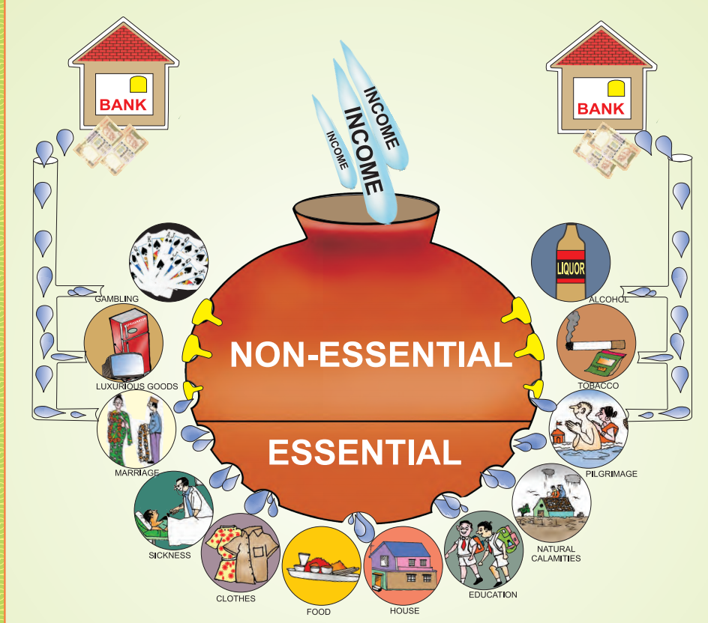
Income,
Subsidies Entitlements
Old age Pension
insurance
Loans

Slide 3
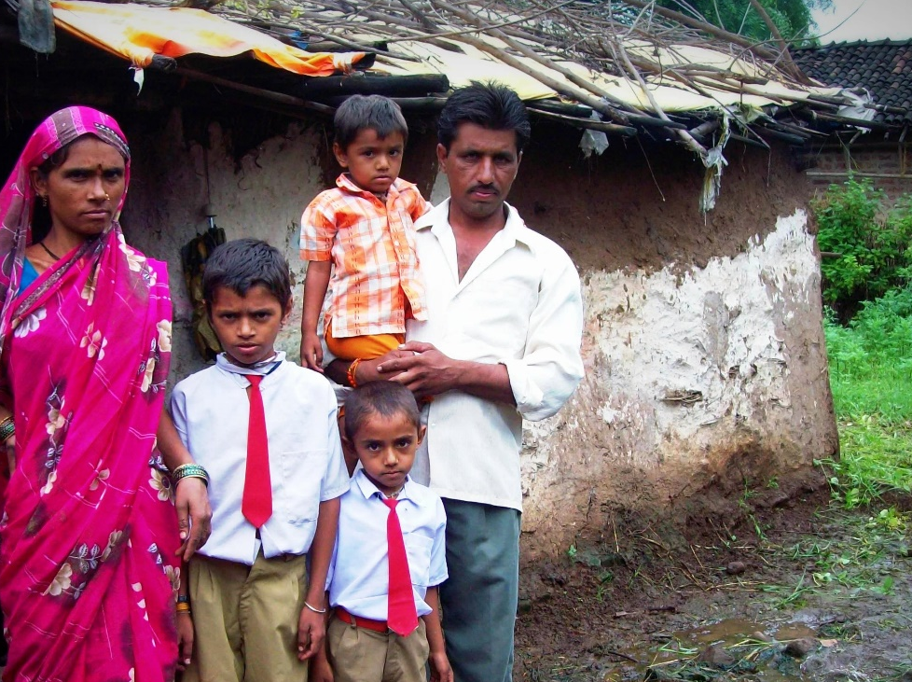
Financial inclusion | वित्तीय समोवेशन: 4 Pillars
Banking
Credit
Insurance
Investment
Small Savings,
PM SB, JJ
Pension
Notes:
Credit
Loan @affordable rates
Savings
Banking
Small Savings
Investment
Long term Lifecycle needs
PENSION, Higher Education
Insurance
Life and Non-Life (General)

Slide 4

Post independent India: Banking Penetration (non-exhaustive)
‘76: Regional Rural Bank (RRB)
‘ 71: State level Bankers’ Committee
‘69: Lead Bank Scheme
’66: Cooperative Banks under RBI’s Ambit
Nationalization of Banks
(‘55, ‘69, ‘80)
‘61: DICGC Act

Slide 5
Banking measures for financial inclusion: Timeline in Recent Years
2005: RBI permitted no-frills account with zero balance
2014: JDY, new Pvt.CB, BMB
2013: eKYC permitted
2006: RBI permits BCA
2016: IMPS, BHIM & other <LINK>
2011: Swabhiman to increase banking presence in rural area
2015: SFB, PB <LINK>
Notes:
Aadhar enabled payment system

Slide 6
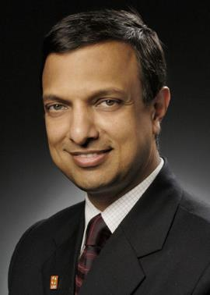
Genesis of Jan Dhan Account?
NACHIKET 6 points | Vision Statement
Bank account | A UEBA by 1/1/2016
Access to bank | 15 minutes walking distance (400) Payment Banks Small Finance Bank
Nachiket Mor
Member of RBI Board
Committee on Financial inclusion (2014)
Notes:
Universal electronic bank account

Slide 7
FinMin: Dept of Financial services: PM-JDY: 6 pillars x 2 phases
Phase-I: 15 August 2014-15
Banking within 5 kms
Account for every family with 5k overdraft, Rupay Card
Micro insurance, Unorganized pension
Sub service area SSA @1-1.5k households with Bank mitra/ Bank
Financial literacy
Credit guarantee Fund
Overdraft defaults
DBT
Phase-2: 2015-18

Slide 8
What exactly is Jan Dhan Account?
Basic Savings Bank Deposit Account (BSBDA)
Age 10/>
Zero balance. But, Chequebook only with “balance”.
Max. 4 withdrawals / month (incl. ATM)
Overdraft (1 per family)
Only one account holder in household (preferably woman)
Min. 6 months history: 4x the or 5k whichever lower.
Interest: Base rate+2% or 12% whichever lower.
Tenure: max. 3 years
Overdraft only with balance history of min. 6 months.
Notes:
Basic Savings Bank Deposit Account (BSBDA)
Age 10/>
Zero balance. But, Chequebook only with “balance”.
Max. 4 withdrawals / month (incl. ATM)
Overdraft only with balance history of min. 6 months.

Slide 9
EVERY Jan dhan account comes with
Insurance
Accident Rs.1 lakh
Life 30k
Premium
NPCi
Govt
Who?
All eligible- hubby,wife
If opened by 31/1/15
But, Rupay should be used every 90 days [initial rule 45 days] - even for checking balance, if not for transaction.
Union Government employees, and income tax payers not eligible
Notes:
Accidental Insurance Cover is Rs.1.00 lac
NPCi pays the 0.47 Rs/card premium to insurer
But, Rupay should be used every 90 days [initial rule 45 days] - even for checking balance, if not for transaction.
Available to all account holders. (husband, wife).
30k life insurance, if was opened first year,
+ 30k life insurance, if opened between 15/8/14 to 31/1/15. (premium Government pays)

Slide 10
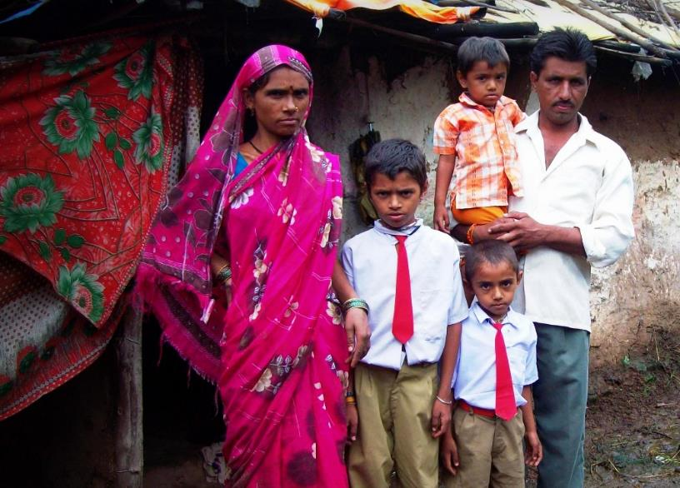



Jan Dhan accounts of a family
5k Overdraft*
A.insurance*
LPG subsidy..
MNREGA..
MNREGA
A.insurance*
overdraft
Scholarship
A.Insurance*
Overdraft

Slide 11
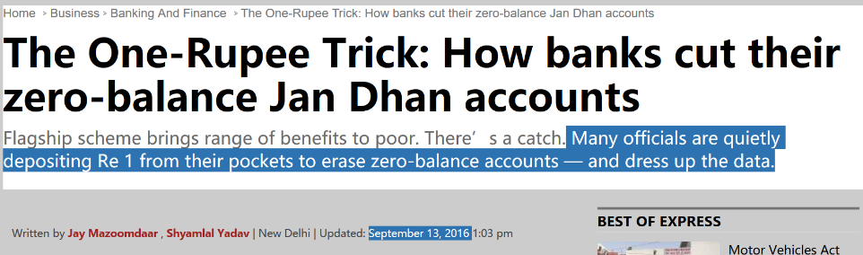
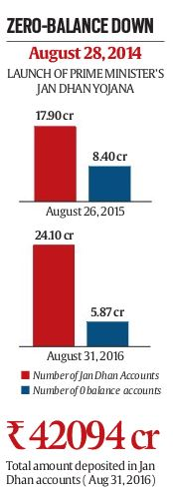
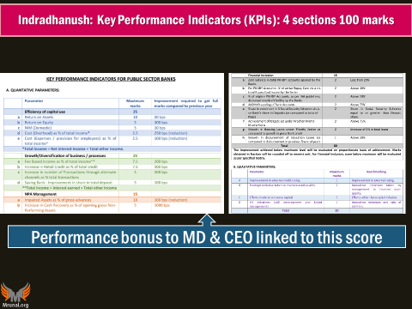
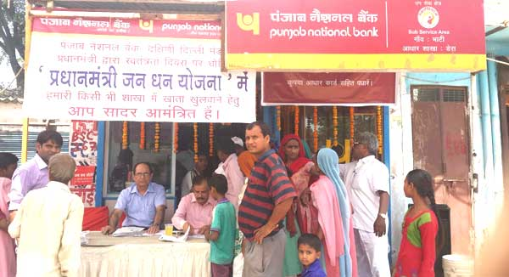
GSM4: will you do it not, if pressure from above?
Paper Ans. No. <But real life PSB bank manager, will have to do ☹ else punishment transfer in “खोपचे वाला” village, So what’s the point of GSM4!?>

Slide 12
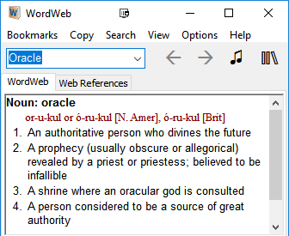
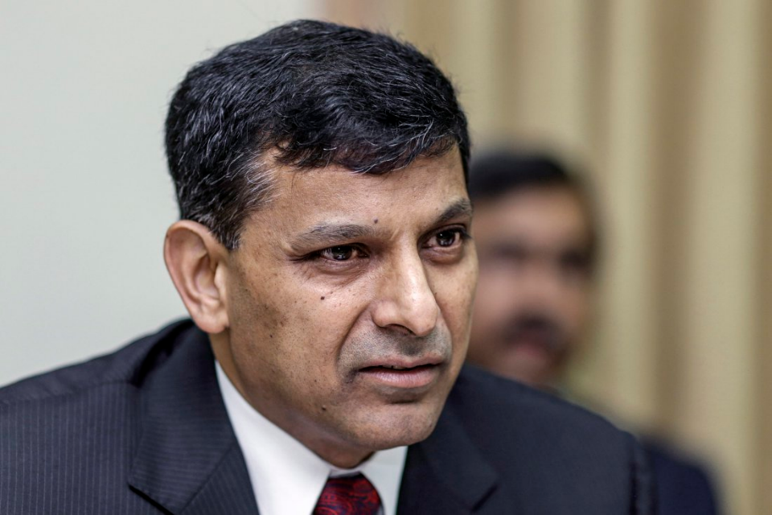
2005
Predicted Subprime crisis (IMF)
2008
Happened
BCA “Bank Mitra” model 2% commission, misconducts by RBI report. 47% untraceable.
2014
Multiple accounts for free insurance
Smurfing using Money mules
Money Laundering
2016
Happened during demonetization.

Slide 13






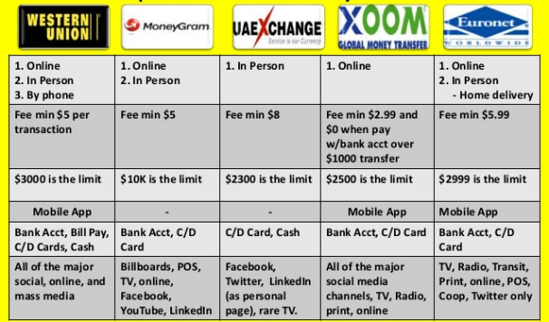
Hawala Operators
30,600
30,000
Western Union
Bank Transfer – charges
Illegal migrant..US Bank?
Income Tax
What if they don’t have account?

Slide 14



Jan Dhan Money Mules and Smurfing?
Money Mules
Hawala Operators
10000
10000
10000
30,600
“Smurfing” : hawala operators would spilt the whole amount into several small units beyond the threshold using several Jan Dhan account holders as money mules.

Slide 15
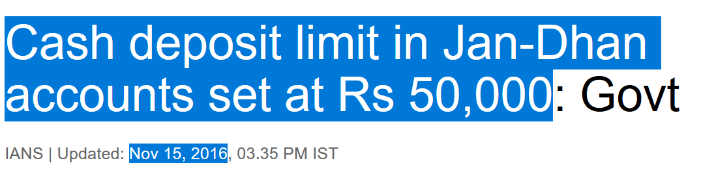

>50k, source of deposits will be verified.
Money Mules
Black
Black
Black
+ withdrawal limit of 10k per month
Aadhar linking of JDY…DATA analytics

Slide 16
Jan Dhan for money-laundering post-Dem? (Rs. Crore)
1.9x rise

Slide 17
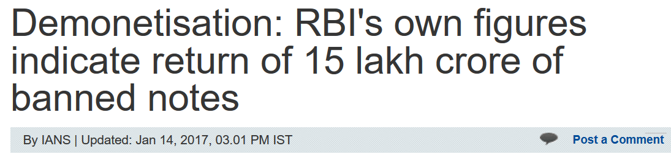
News after two months!!
Mainly 9 Tricks were used:
Backdated FD in cooperative banks (soln: CBS between PACS & DCCB)
Jan Dhan Money mules (Soln: Aadhar Seeding)
There are 7 more...<Black money Lecture>
SBN: total 15 lakh cr.
97% returned
Rs.54,000 cr black money destroyed
Notes:
http://economictimes.indiatimes.com/news/economy/finance/recall-could-cost-a-massive-rs-1-28-lakh-crore-says-cmie/articleshow/55608552.cms

Slide 18
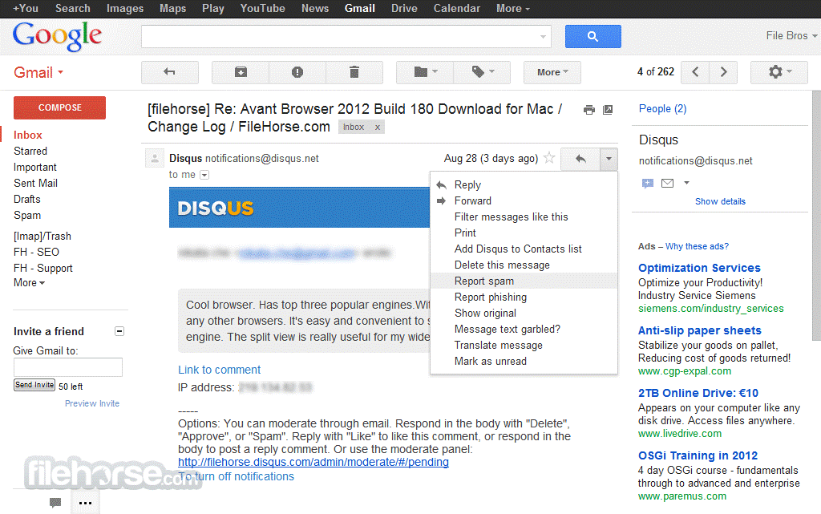
Google gives you free account, then how does it make money?

Slide 19


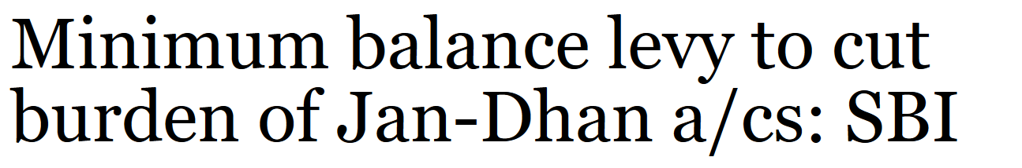
SBI monthly average balance (MAB) WEF 1/4/2017
Cross subsidization
MAB Stopped in 2012 to get new customers
Area | MAB | Penalty (+ service tax extra)
Metro | 5,000 | Rs.50: (if upto 50% below LAB) 100 (if 75% below MAB)
Urban | 3,000
Semi-Urban | 2,000
Rural | 1,000 | 20-50
ZERO Balance account, “1 rupee account” but CBS – data, server, documents
Limits on cash deposit, withdrawal, locker usage [else extra charges ☹]

Slide 20
Financial inclusion | वित्तीय समोवेशन: 4 Pillars
Banking
Credit
Insurance
Investment
Small Savings,
PM SB, JJ
Pension
Notes:
Credit
Loan @affordable rates
Savings
Banking
Small Savings
Investment
Long term Lifecycle needs
PENSION, Higher Education
Insurance
Life and Non-Life (General)

Slide 21

Financial Inclusion: Loan / Credit <list not exhaustive>
PSL- RBI <LINK>
Padho Pardesh
40% SCB | 75% on RRB & SFB
MUDRA Yojana (Dept of Fin.Services)
Shishu, Tarun,Kishor upto Rs.10 lakh <Link>
Edu Loan scheme for Minorities by Minority Affairs Ministry
ISS
Farm loans: NABARD refinance, 3% subvention by Department of financial services.
Affordable Home Loans (PM-Awas Yojana-Urban. more in infra lecture)
Stand up India (SIDBI)
Credit (+) approach = training also given.
Each bank branch to give 10k to 1 cr. Loan to 1 SC/ST and 1 Women for green-field non-farm.
BMB: loans without collateral to women <MERGED>
List is not exhaustive, since fifty dozen loan schemes from women, weavers to exporters. But these are important ones.

Slide 22
Financial inclusion | वित्तीय समोवेशन: 4 Pillars
Banking
Credit
Insurance
Investment
Small Savings,
PM SB, JJ
Pension
Notes:
Credit
Loan @affordable rates
Savings
Banking
Small Savings
Investment
Long term Lifecycle needs
PENSION, Higher Education
Insurance
Life and Non-Life (General)

Slide 23
Small Savings Schemes: TOTAL 8 (Dept of Economic Affairs)
4
Post Office schemes: monthly, 5 year, savings, time deposit [1873]
1
National Savings Scheme (NSC) ‘ 59
1
Public Provident Fund (PPF) ;68
1
Kisan Vikas Patra 1988-11, 2014
1
Senior Citizen Savings 2004
&
Sukanya Samriddhi Yojana (BBBP)
Govt savings bank act
Government Savings Certi act ‘59
PPF act
Govt savings bank act
Government Savings Certi act ‘59
No act
National Savings Institute, Ministry of Finance (DEA), Nagpur

Slide 24
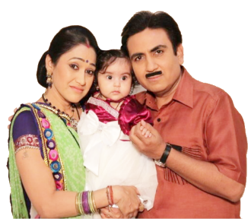
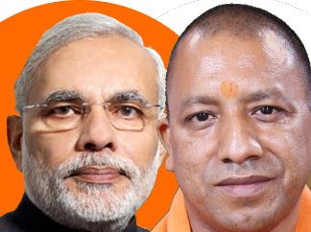


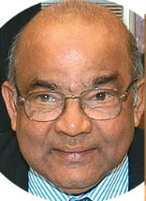
Money goes to national small savings fund (NSSF)
SSS offer high interest rate (9%)-> expensive for states to borrow.
1/4/16: only selected states can borrow: Arunachal Pradesh, Delhi, Kerala and Madhya Pradesh [with caveats]
Deposited money to union borrowing. + one time lending to FCI (food security)
Notes:
Union Cabinet chaired by the Prime Minister Shri Narendra Modi has given its approval to exclude State Governments States/UTs (with Legislature) except Arunachal Pradesh, Delhi, Kerala and Madhya Pradesh from National Small Savings Fund (NSSF) investments from 01.04.2016. It also approved providing a one-time loan of Rs. 45,000 crore from NSSF to Food Corporation of India (FCI) to meet its food subsidy requirements.

Slide 25
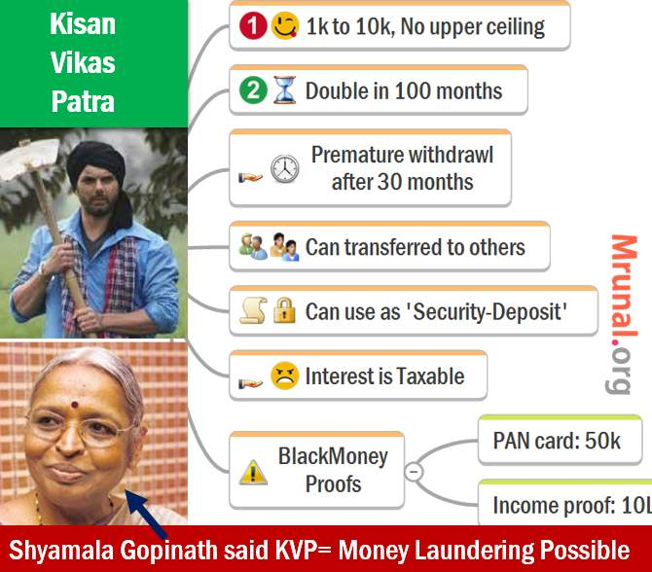
Directorate Small savings, via post office
8 years 4 months

Slide 26


Annual tax free interest (9.1.% presently 8.4%)
Enrollment: 0-10 years
Annual deposit:
1k to 1.5L
Deposit only upto 14 age.
50% withdrawal after 18 age (if not married)
100% withdrawal @21 (or before 21 if married )
Sukanya Samriddhi Yojana 2015 [Dept of Economic Affairs decides interest]

Slide 27
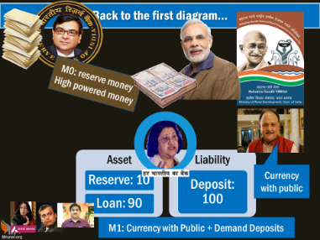
SBI: 5 year term-deposit
Year
2012
2015
Nominal
Interest
9.25% SBI
Minus
Inflation
-11%
-5.4%
Real Interest Rate
-1.75
7.00% SBI
+1.6
8.7% KVP
2015
-5.4%
+3.3

Slide 28
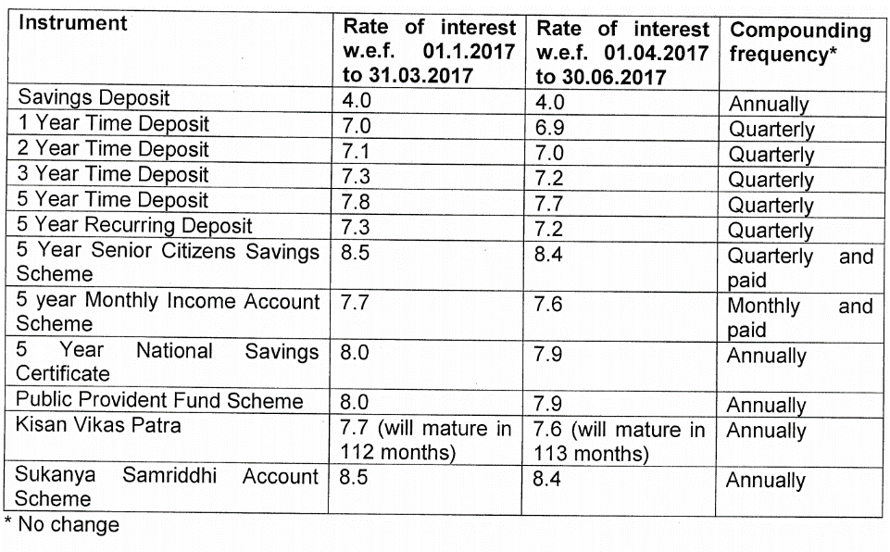
Finance ministry -> dept of Economic affairs-> quarterly update
Inflation controlled-> even if nominal interest ▼ still real interest =/▲
Align with bank deposit rates => monetary policy transmission.

Slide 29
Financial inclusion | वित्तीय समोवेशन: 4 Pillars
Banking
Credit
Insurance
Investment
Small Savings,
PM SB, JJ
Pension
NEXT: “Social Security”
Notes:
Credit
Loan @affordable rates
Savings
Banking
Small Savings
Investment
Long term Lifecycle needs
PENSION, Higher Education
Insurance
Life and Non-Life (General)

